Slide 1
CyberSafety and Systems Support for AI at the Edge
Shiv Mishra
Professor
Computer Science, CU-Boulder
Office: Systems lab: ECCR 1B22
Email: mishras@colorado.edu
http://www.cs.colorado.edu/~mishras

Slide 2
Current Research Focus - System support for IoT - Social Computing
System Support for Edge Computing
Inter-container Communication
Distributed Scheduling at the Edge
Smart Agriculture
CyberSafety
Hate speech in Arabic social media
Snapchat as a Lens on Public Health
Radicalization by YouTube’s Recommendation Algorithm
Democracy and Technology
Impact of Russian bots
Misleading news and critical thinking
Resilience and Interventions
Socio-Technical Systems
Impact of Planned Disruptions
Health and social wellbeing
Environmental justice communities

Slide 3
System Support for Edge Computing

Slide 4
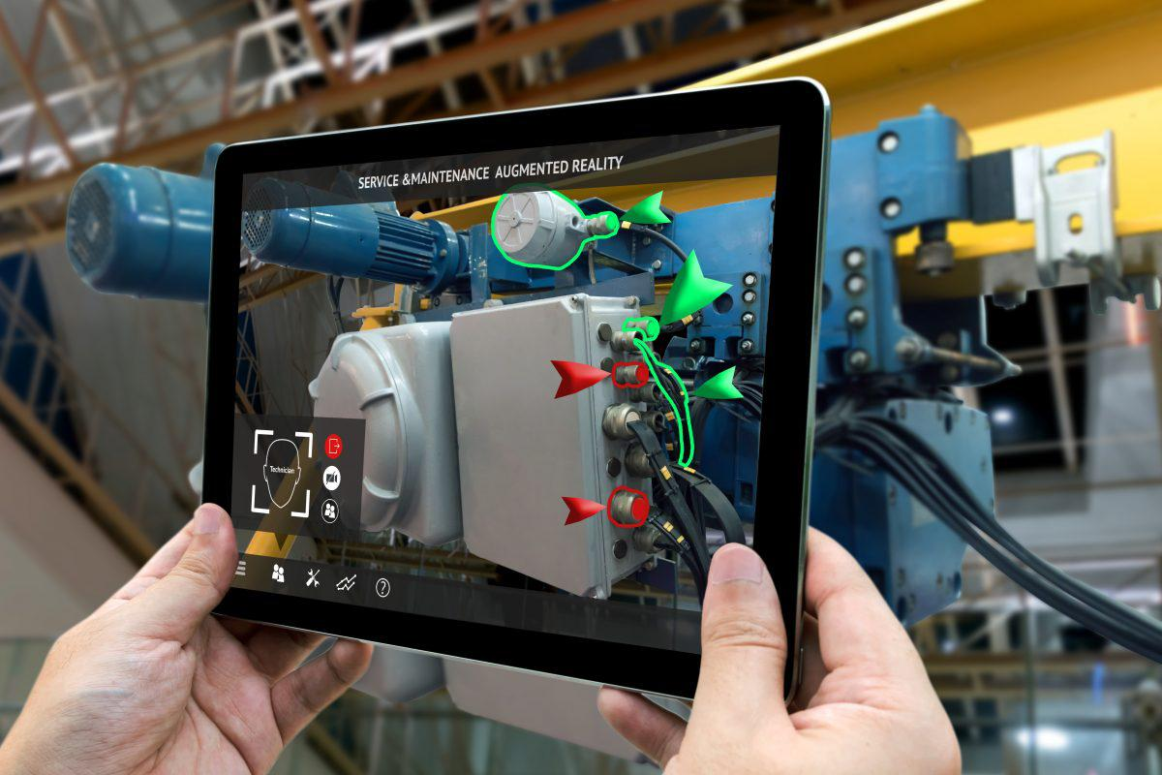
Problem: Augmented Reality
Task: To overlay useful labels over objects in a video stream
Data: Large volume, privacy-sensitive, location-sensitive, limited lifetime
Computation: Live video stream capture and frame segmentation, object recognition, information overlay, …
Requirements: Compute intensive, context aware, real time, privacy preserving

Slide 5
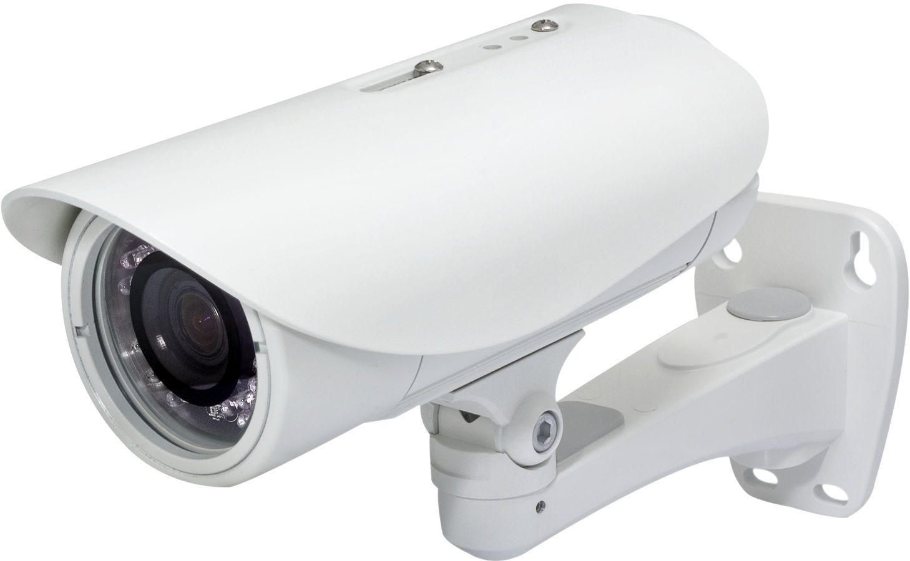
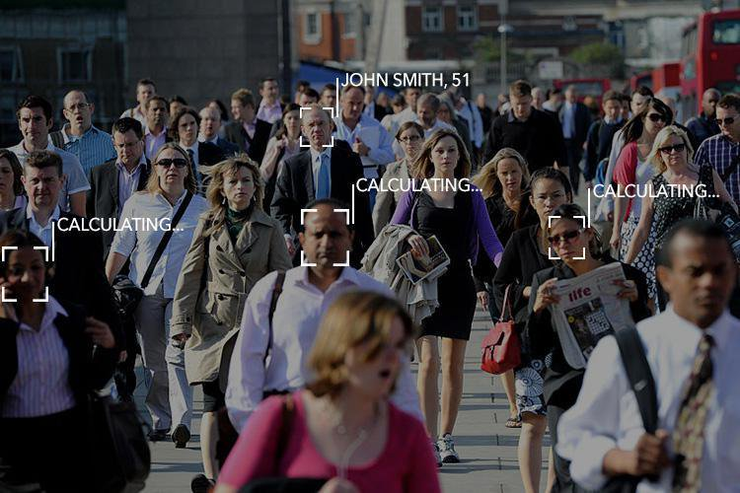
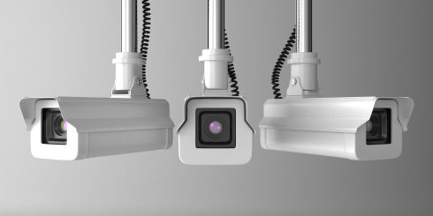
Problem: Identifying and tracking people
Task: To identify and track people in a moving crowd in real time
Data: Large volume, multiple sources, location-specific, privacy-sensitive, limited lifetime
Computation: Face recognition and tracking
Requirements: Compute intensive, context aware, real time, privacy preserving

Slide 6
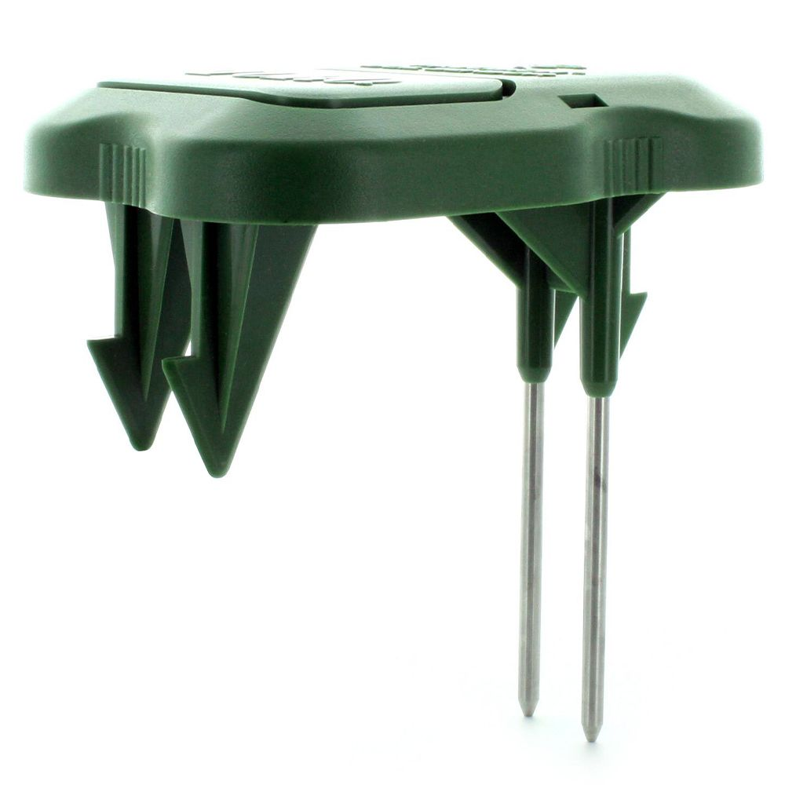
Problem: Smart Agriculture
Task: Smart irrigation, fertilizer application, crop disease prevention, locating weeds, …
Data: Large volume, multiple sources, hybrid, location-specific, limited lifetime
camera
Computation: Pattern recognition, anomaly detection
Requirements: Compute intensive, context aware, near real time

Slide 7
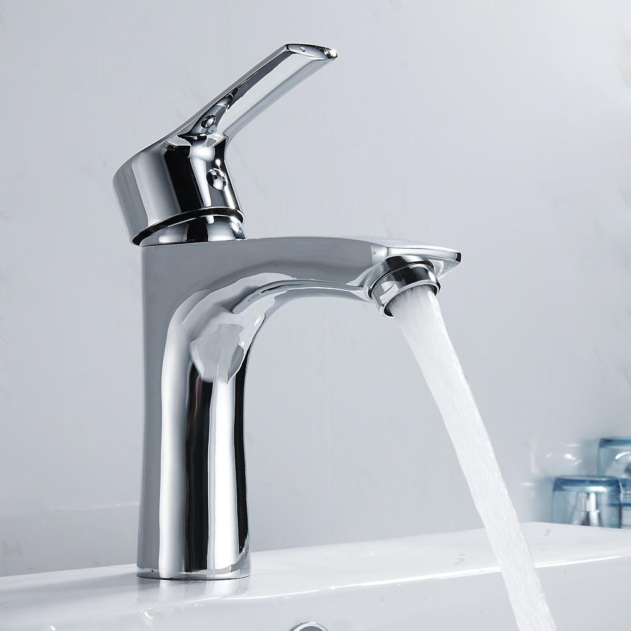
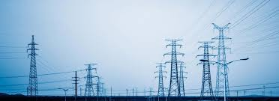

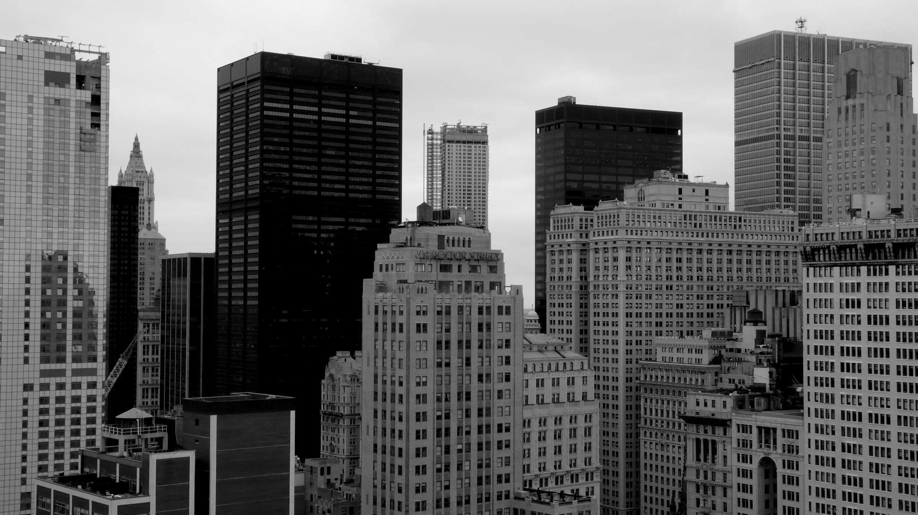

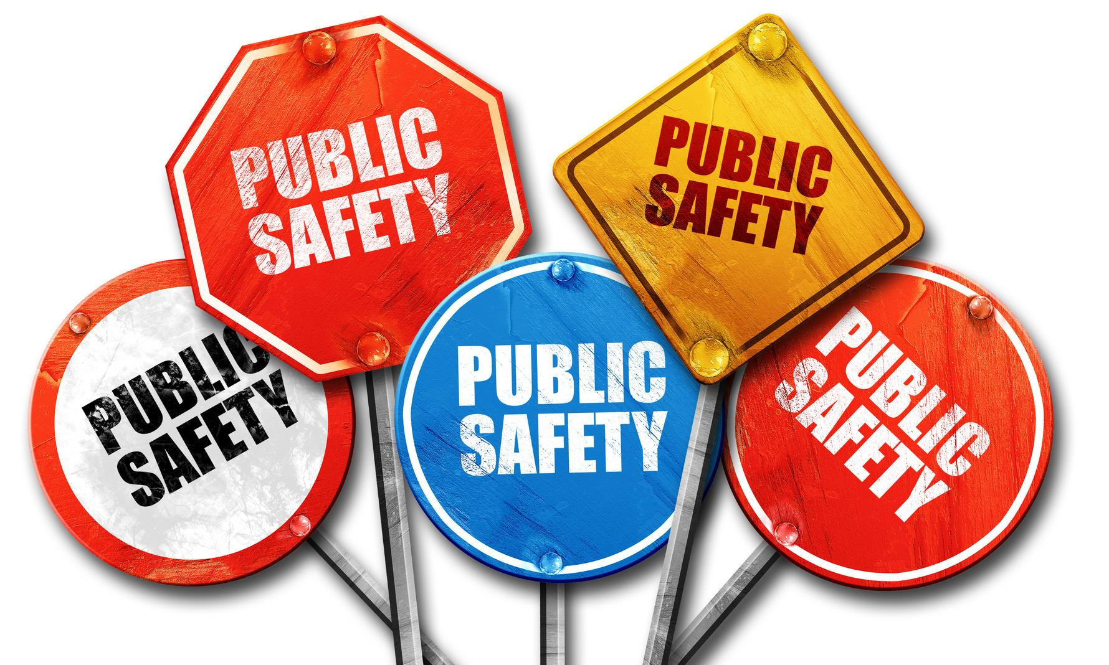
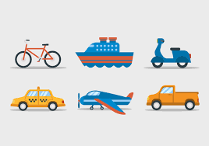
Problem: Management of city operations
Task: Optimal water and energy distribution, traffic management, smart buildings, public safety, …
Water
Energy
Buildings
Data: Large volume, multiple sources, hybrid, location-specific, limited lifetime, privacy sensitive
Mobility
Public safety
Computation: Optimization, anomaly detection, context aware
Requirements: Compute intensive, context aware, real or near real time, privacy preserving

Slide 8
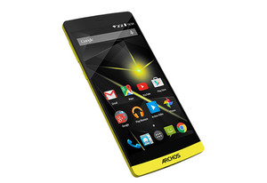
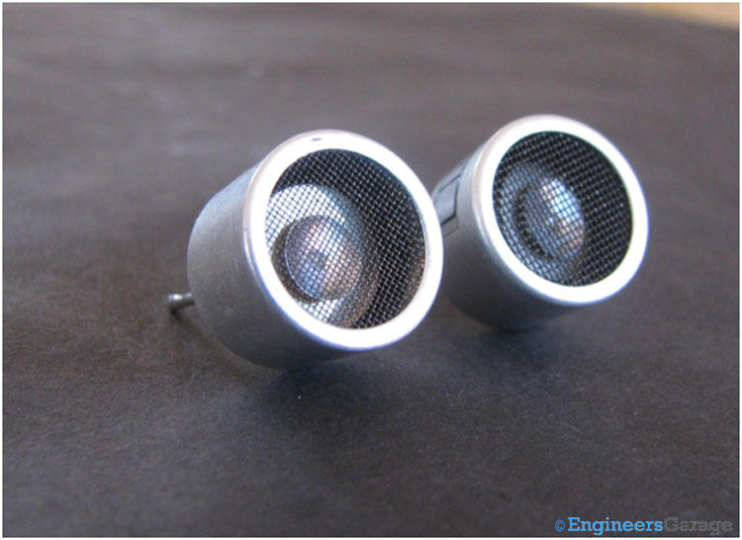
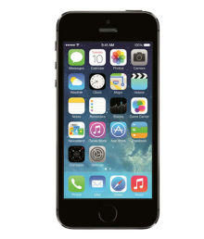
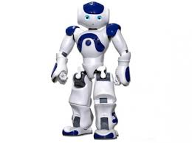
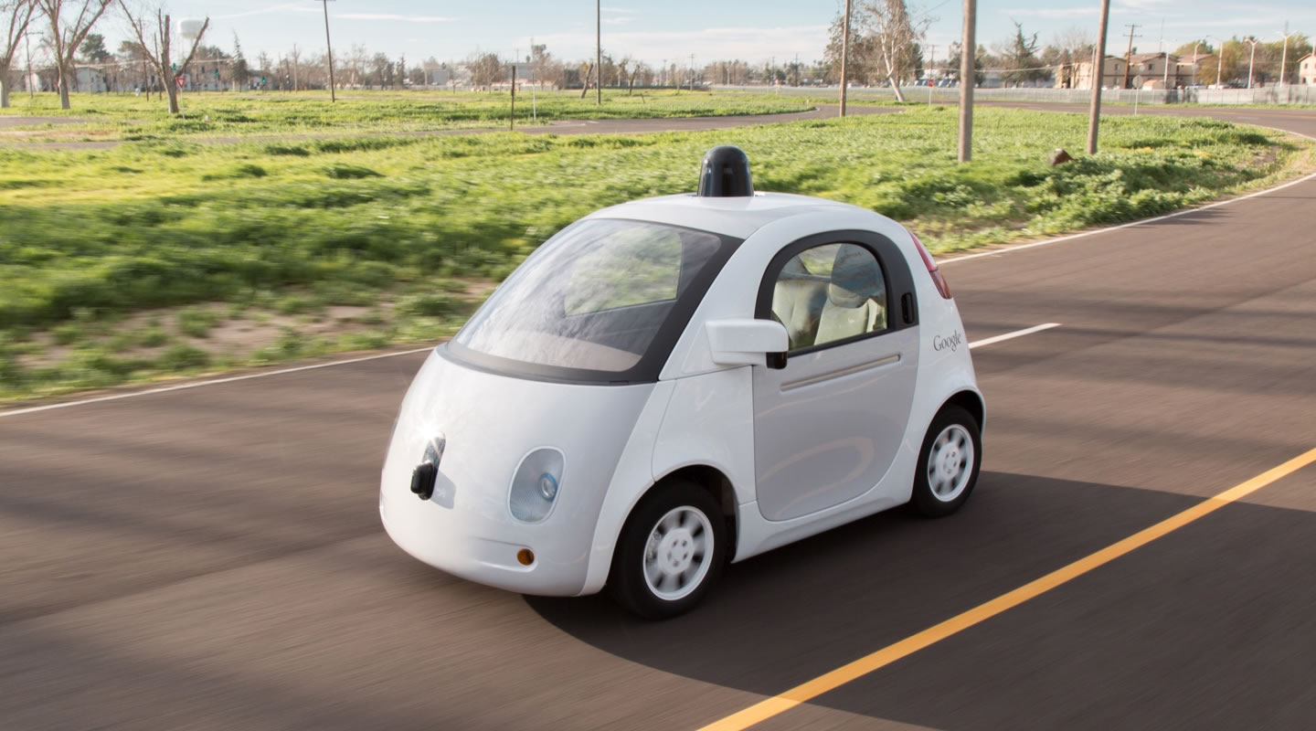
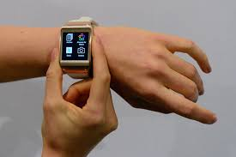
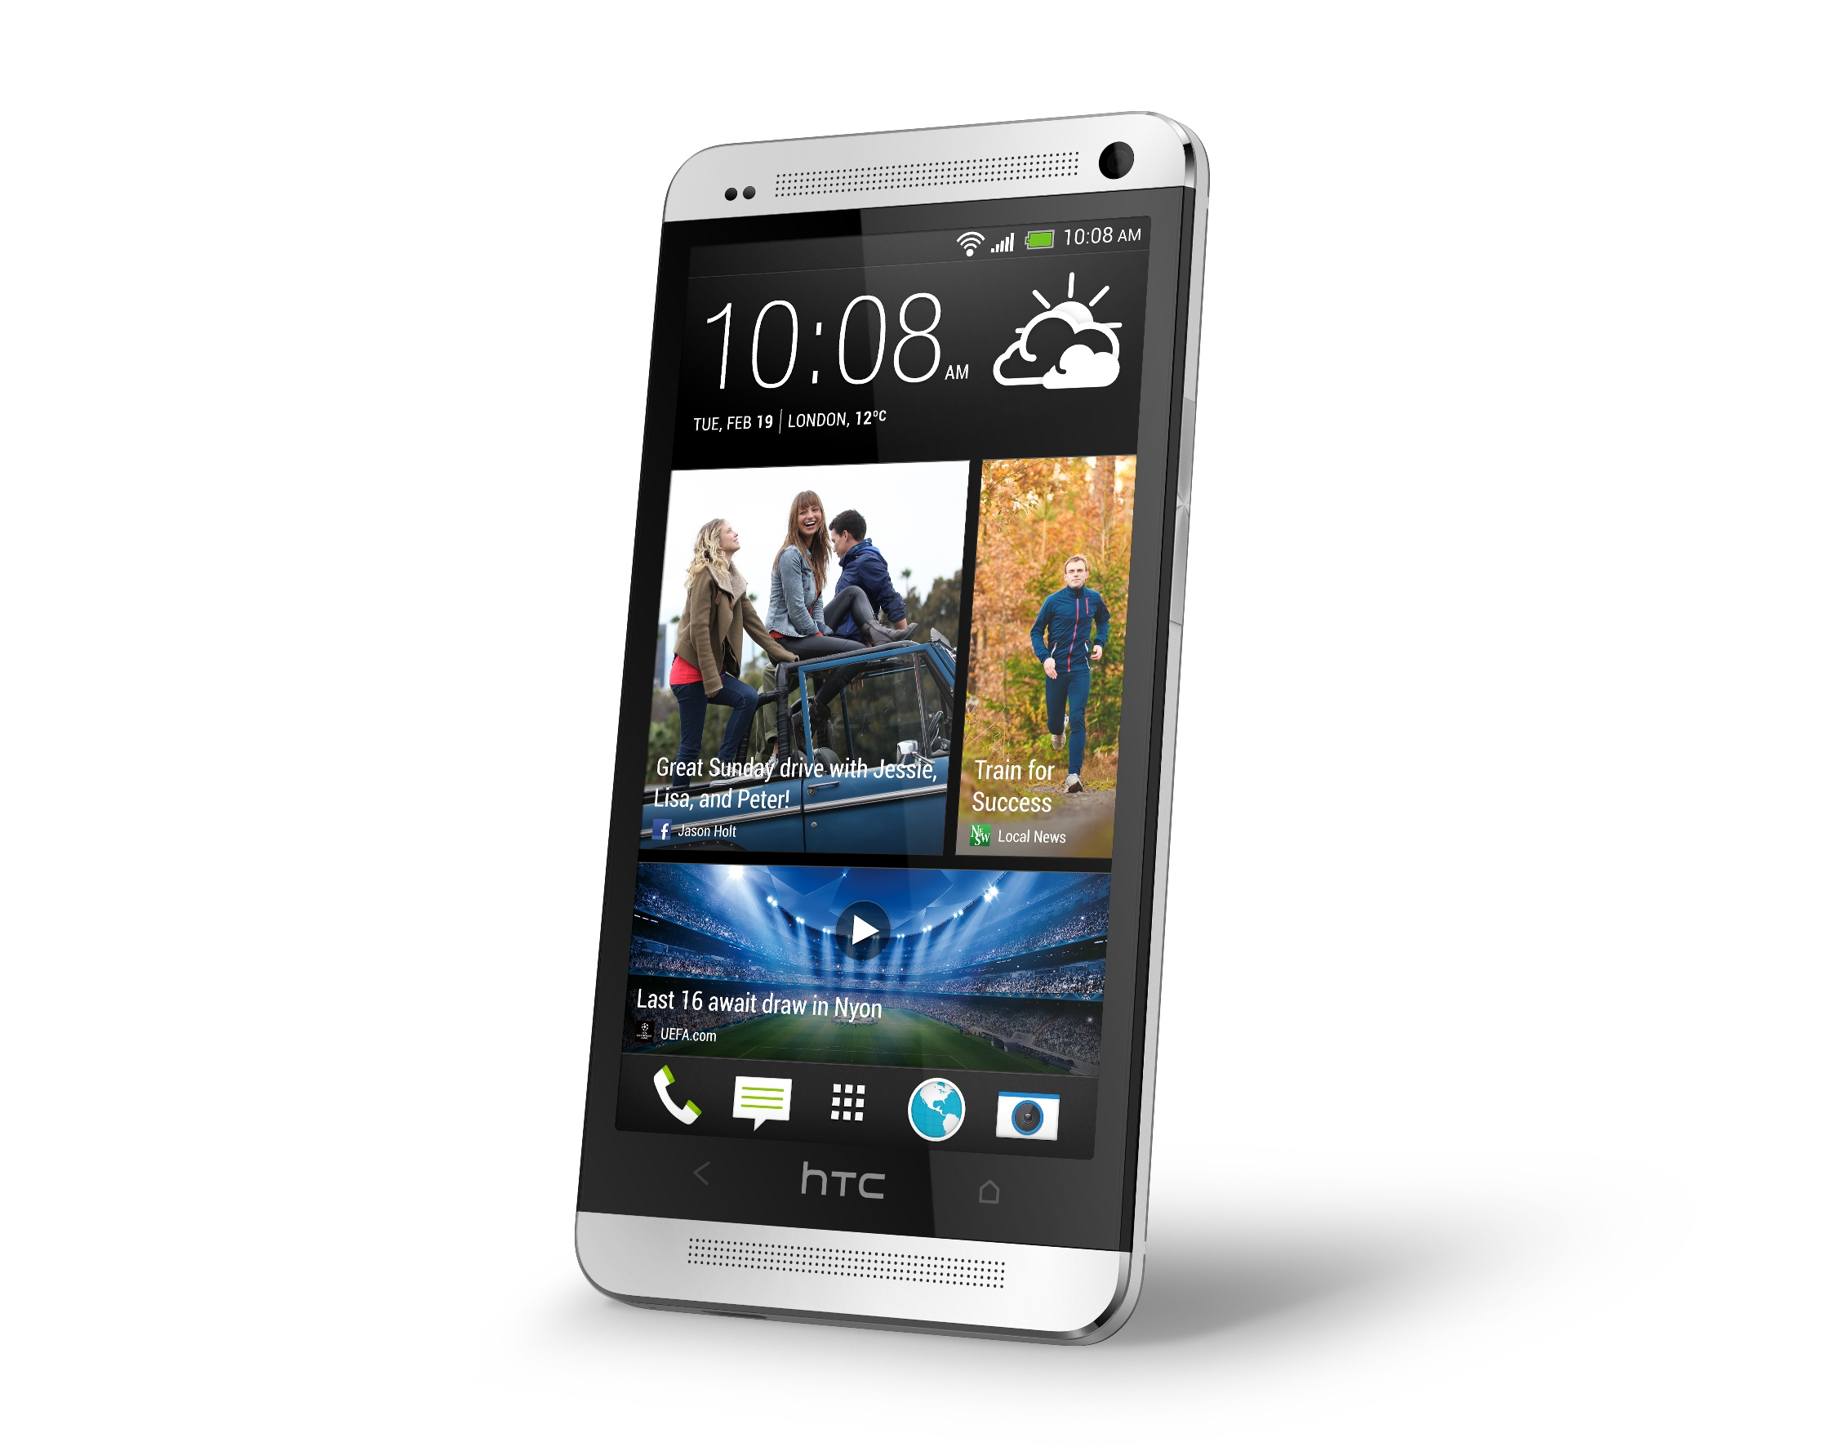
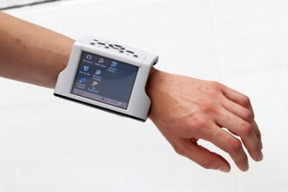
IoT Environment
Environment
sensor
Camera
Personal air
Pollution sensor
Smart watch
Autonomous car
Static and mobile sensors are generating lots of sensor data in real time
Robot
Health monitor
Smartphone
Goal: To provide highly sophisticated, personalized, context-aware services in (near) real time
with humans in the loop

Slide 9
IoT Environment
Key Question: Where to collect and process the sensor data to build sophisticated, context-aware services?
Onsite Computing
Limited resources (power, CPU, memory), device heterogeneity
Computing in the Cloud
High latency, high bandwidth consumption, privacy leakage, lost context, …
Edge Computing
Put services and resources of the cloud closer to users, possibly with in one wireless hop

Slide 10

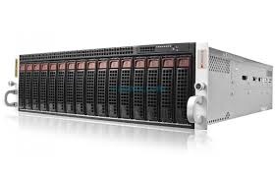
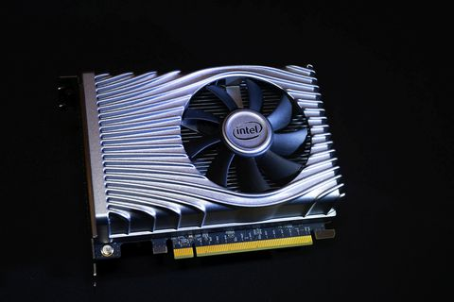
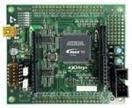
Edge Computing
Edge Server: CPU, GPU, FPGA, …
Data center in a box, closer to the sensors
Represents the middle tier of a 3-tier hierarchy: onsite – edge - cloud
+
Edge computing: Low latency, low bandwidth consumption, separate administrative domains, security & privacy
Water
Energy
Buildings
Mobility
Public safety

Slide 11
Edge Computing
Key driving technology for building sophisticated, context-aware, real (or near real) time IoT and smart city services

Slide 12
Edge Computing: Challenges
Building sophisticated, context-aware applications at the edge is a complex task at present
Lack of any integrated system level support available to configure these applications
Heterogeneity of computing resources and sensing devices at the edge
Dynamic nature of the computing environment with mobile as well as static computing devices
Lack of trust among the collaborating entities
Minimal support to manage resource sharing

Slide 13
Research Goal: To develop and evaluate system level services to enable an efficient microservice-based architecture at the edge
Cloud Layer
An application is implemented by composing a set of “microservices”
Each microservice implements a basic functionality
A microservice runs in an “isolated” computing environment
LXC, dockers, etc.
Scale each microservice up or down
Edge Comuting Layer
Sensor Layer

Slide 14
Edge Computing: Inter-Container Communication
Local communication
Observation: Inter-container communication is a key bottleneck in the application’s performance
Solution: Use shared memory channels
Bi-directional streams (as in TCP/IP) or publish/subscribe channels
Co-located containers:
hostIPC = true
Remote communication by synchronizing memory regions via Remote Direct Memory Access (RDMA) (in progress)
Integrated with Kubernetes
Shimmy
agent
Shm region
Container 1
Container 2
Remote communication
Shimmy
agent
Shimmy
agent
Shm region
RDMA Server
RDMA Client
RDMA Client
RDMA Server
Shm region
Container 1
Container 2
Container 3

Slide 15
Edge Computing: Container Graphs
Problem: any architectural level change in Kubernetes incurs service disruption
Solution: Dynamic container instantiation & orchestration
Dynamic instantiation or removal of micro-services
Dynamic alteration of communication pattern among micro-services
Current application operation or its data-flow remains undisturbed
No application downtime
Kubernetes compatible

Slide 16
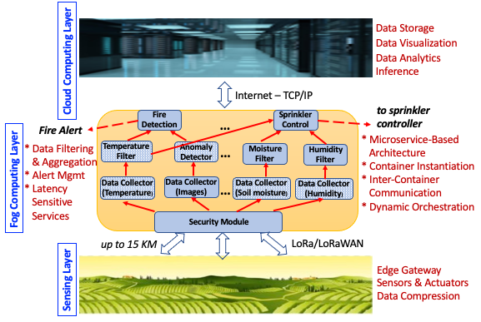
Edge Computing: Smart Agriculture
To develop an end-to-end, LoRa-enabled, edge-based infrastructure for smart agriculture in India and USA
Sensing layer: sense the agriculture field parameters and communicate them to Fog layer using LoRa
Fog layer: provide support for latency-sensitive services as well as operation in a disconnected environment
Cloud layer: Complex, compute-intensive decision making and long-term data storage and visualization.

Slide 17
Edge Computing: Distributed Scheduling
A scheduler that schedules tasks among multiple heterogeneous processors to satisfy application’s constraints
Application constraints: deadlines, privacy, cost, …
Processors: Low-end devices, CPUs, GPUs, FPGAs, …
Challenge: How to keep the overhead of “making scheduling decisions” low

Slide 18
Edge Computing: Privacy
Several privacy-at-the-edge related projects
Individual and group-based privacy negotiation mechanisms at the edge
Privacy leakage in home automation systems
Support for monitoring GDPR (General Data Protection Regulation) policies in IoT systems

Slide 19
Contributors
Current Students: Fei Hu, Md. Rezwanur Rahman, Jinpeng Miao, Chris Godley, Kunal Mehta, Nisha Murarka
Khaled Alanezi , Mohammed Al-Mutawa
Sepideh Goodarzy, Maziyar Nazari, Marcelo Abranches
Vasu Sharma, Mana Khasgiwale, Prashanth Thipparthy, Hamza Motiwalla, Meeti Baliga, Biljith Thadichi, Srihaasa Pidikiti, Hima Boddupalli

Slide 20
Social Computing

Slide 21
CyberSafety: Introduction
Problematic issues that arise while surfing the Internet
Examples: Cyberbullying, obscene content, misinformation, propaganda, …
Goal: To develop tools to automatically detect cybersafety issues, assess their impact, and techniques to mitigate any negative impact

Slide 22
CyberSafety: Deradicalizing YouTube
Investigate how YouTube’s recommendation algorithm plays a role in online radicalization via surfacing extreme content
Prevalence of religiously intolerant Arabic YouTube videos, the tendency of the platform to recommend such videos, and how these recommendations are affected by demographics and watch history.
Used YouTube’s API to collect data
Using crowdworkers, acquired annotations for a subset of videos to identify the ones promoting religious hate along with the targeted religious group(s)
For each video, collected its top four recommendations going five levels deep
Effect of personalization: carefully crafted eight different user profiles, each with a distinctive set of personal attributes

Slide 23
CyberSafety: Snapchat as a Lens on Public health
Investigate how exposure to food snaps impacts the eating habits of the users
Collected Snapchat snaps from users in three different countries
Identified food-related snaps
Conducted user studies

Slide 24
CyberSafety: Hate speech in Arabic social media
Religious hatred is a serious problem on Arabic social media (Twitter, YouTube)
Goals: (1) Quantify and characterize religious hate speech on Arabic Twitter space; (2) develop classifiers to automatically detect religious hate speech in Arabic social media; and (3) To develop tools to detect bots involved in spreading religious hate
Collected a large dataset of Arabic tweets and analyzed for religious hate content
Developed classifiers to detect religious hate in Arabic Twitter
Developed tools to detect bots in Arabic twitter

Slide 25
CyberSafety: Content Deletion and ﻿Moderation on
Social Media Platforms
Social media platforms strive to moderate their content by censoring, demonetizing and/or removing posts that allegedly violate their community guidelines
Such practices could be met with resentment, anger, and in some cases, violence by users, especially if they are seen as unjust
Users also sometimes delete their posted content for various reasons, one of which could be regret
Goal: To understand the characteristics of posts that get deleted, and an ability to predict deletion before posting contents on these platforms to help reduce any aftermath of unfortunate consequences

Slide 26
Monitored about 74,000 YouTube videos
~18% were deleted with in first seven days
Done a detailed analysis of the features that (1) distinguish deleted videos from undeleted ones, (2) distinguish videos deleted by YouTube from videos deleted by users
Developed classifiers to predict videos that will likely get deleted

Slide 27
Contributors
Nuha Albadi, Maram Kurdi

Slide 28
Democracy and Technology

Slide 29
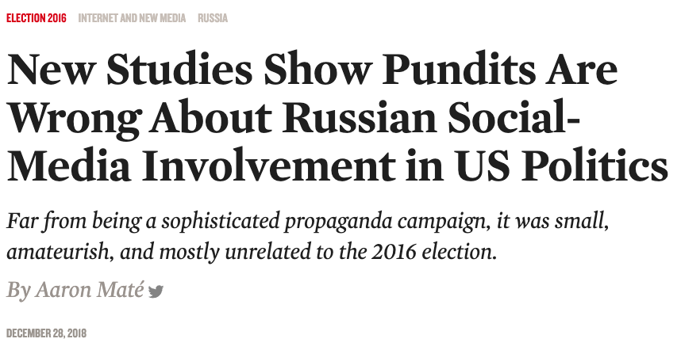
Democracy and Technology: Impact of technology
on our democratic process
“The FBI's work was taken over in May 2017 by former FBI director Robert Mueller, who led a Special Counsel investigation until March 2019.[2] Mueller concluded that Russian interference was "sweeping and systematic" and "violated U.S. criminal law", and he indicted twenty-six Russian citizens and three Russian organizations. The investigation also led to indictments and convictions of Trump campaign officials and associated Americans, on unrelated charges.” (Wikipedia entry for Russian Interference in Elections)
A serious mismatch is gradually developing between two seemingly unrelated issues:
The penetration of science and technology into all aspects of our life, and
Democracy, as practiced throughout the free world
Could these technologies endanger the foundations of liberal democracy?
Goal: To strengthen democracy through technology

Slide 30
Current Project
Evaluate impact of Internet Research Agency (IRA) behavior on Twitter users in the time before the 2016 U.S Presidential Elections

Slide 31
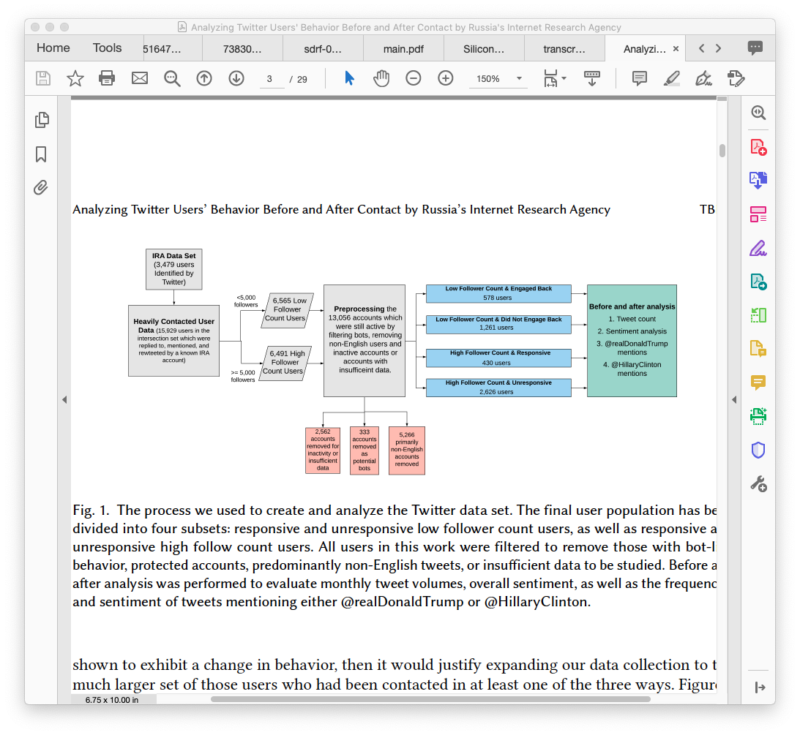

Slide 32

Before and After Analysis
Increased monthly tweet activity for users that interacted with IRA
Increase in the negativity of the sentiments in users that interacted with IRA
Increased mentions of @RealDonaldTrump and @HillaryClinton in users that interacted with IRA
Random baseline shows the changes are not generalizable to the rest of Twitter population

Slide 33
Democracy and Technology: Other projects
Characterization of Toxicity Across Social Media Platforms
Analyzing Behavioral Changes of Twitter Users After Exposure to Misinformation
Understanding How Readers De- termine the Legitimacy of Online News Articles in the Era of Fake News

Slide 34
Contributors
Rick Han, Tamara Lehman, Christine Lv
Jason Shuo Zhang
Rhett Hanscom, Yichen Wang
Upasana Dutta, Srihaasa Pidikiti

Slide 35
Socio-Technical Systems

Slide 36
Socio-Technical Systems: Introduction
Communities in the US and around the world are entering a new era of transformation in which residents and their surrounding environments are increasingly connected through rapidly-changing intelligent technologies
A socio-technical system refers to the interrelatedness of social and technical aspects of a community
This interaction of social and technical factors creates the conditions that are beneficial to the community
Research Goal: To exploit this intelligent technology now accessible to the end users to improve their health and well-being

Slide 37
Empowering Environmental Justice Communities with Smart and Connected Technology: Air and Noise Pollution, Wellbeing, and Social Relations in Times of Disruption

Slide 38
To study two planned built environment disruptions in Denver, the C70 project and the NWC redevelopment
The Central 70 project (C70) is a 10-mile stretch of the I-70 interstate through northeast Denver where the interstate is being widened, an underground viaduct removed, and a section lowered
The National Western Center (NWC) redevelopment is doubling the complex footprint and land acquisition
Three affected communities
Globeville, Elyria-Swansea, and Cole
Low socio-economic status, high unemployment, less than high school education, mostly Hispanic
A long legacy of environmental contamination

Slide 39
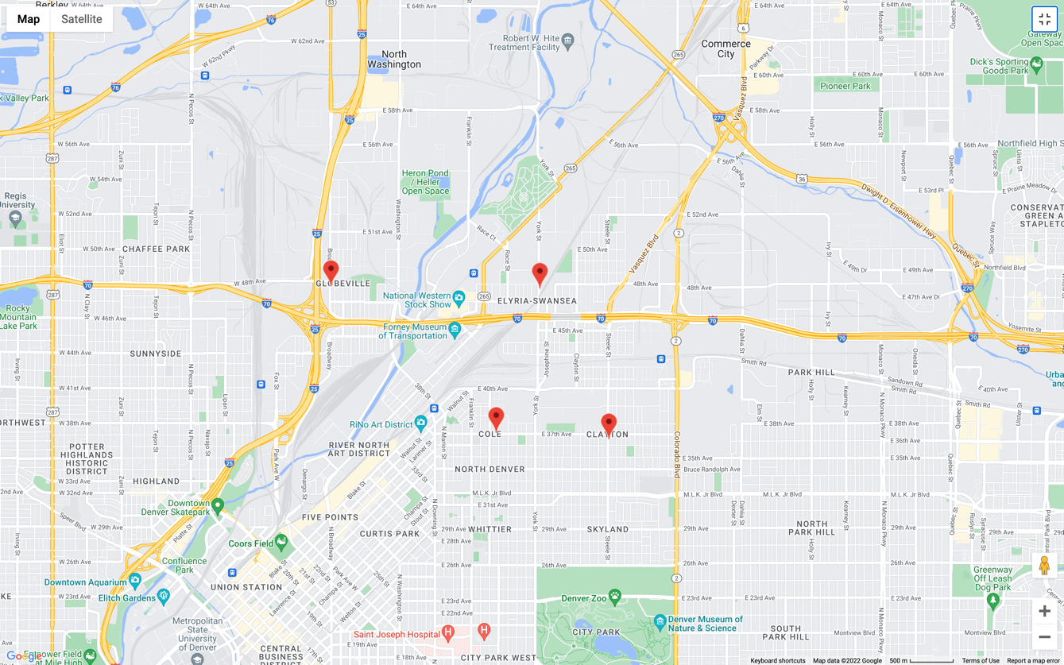

Slide 40
Current Project
To build a socio-technical system comprised of environment sensors, smartphone platforms, and a data analytics server equipped with predictive modeling and visualization to
understand the personal environment (air and noise pollution), individual wellbeing, and social relations of environmental justice communities affected by a major planned disruption in their built environment
mitigate negative impacts of a planned disruption, and
equip policy and decision makers with information in advance about potential negative impacts of upcoming disruptions to help them plan appropriate safeguards.

Slide 42
Three Smartphone Apps
PureMotion
PureConnect
PureNav
Personal air monitors
Deployment over four cohorts
Winter 2021, Summer 2022, Winter 2022, Summer 2023

Slide 43
Contributors
Shelly Miller, Esther Sullivan, Nicholas Clements
Omar Hammad, Md. Rezwanur Rahman, Gopala Kanugo, Neerab Pathipaka, Jacob McKinney

Slide 44
I am looking for students interested in participating in any of these projects
Ph.D., MS thesis, MS independent study, Undergraduate thesis
If you are interested
Email me: mishras@colorado.edu
Thank You!!!

